Slide 2
Kuwait

Slide 3
Introduction

Slide 4
Kuwait City

Slide 5
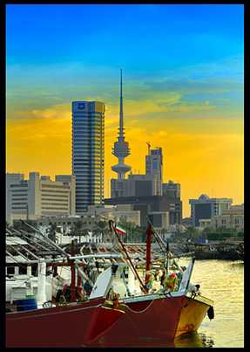
Kuwait City Harbour

Slide 6
Kuwait Towers

Slide 7
Liberation Tower

Slide 8
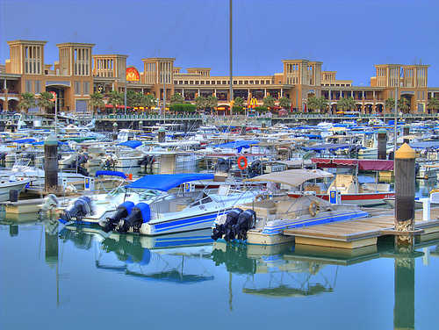
Sharq Harbour

Slide 9
Mosque

Slide 10
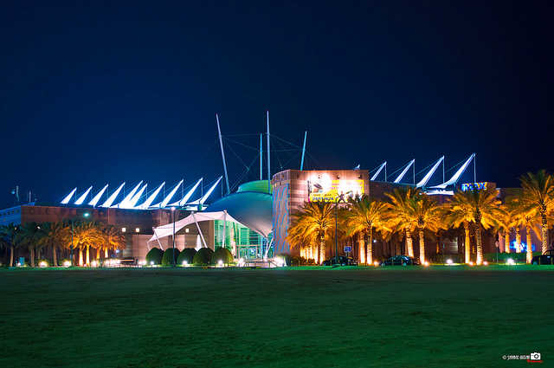
Scientific Centre

Slide 11
Tareq Rajab Museum

Slide 12
Light Dome

Slide 13
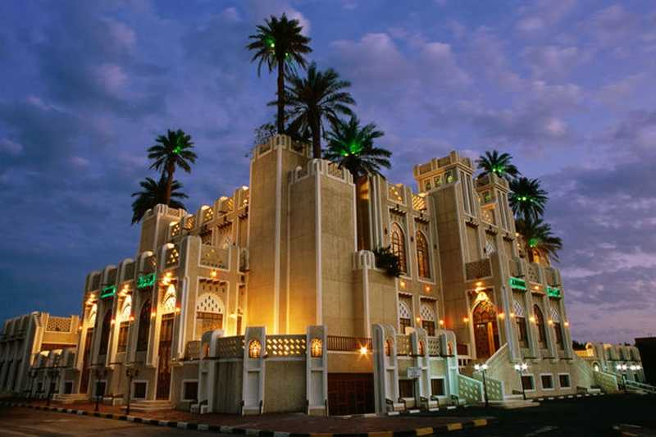
Al Zumerida Hall

Slide 14
Places to Visit

Slide 15
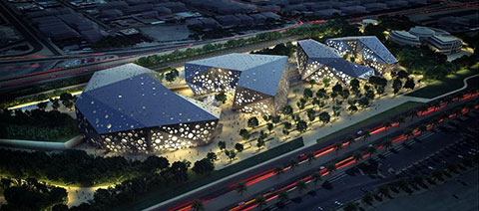
Sheikh Jaber Al-Ahmed Cultural Center

Slide 16
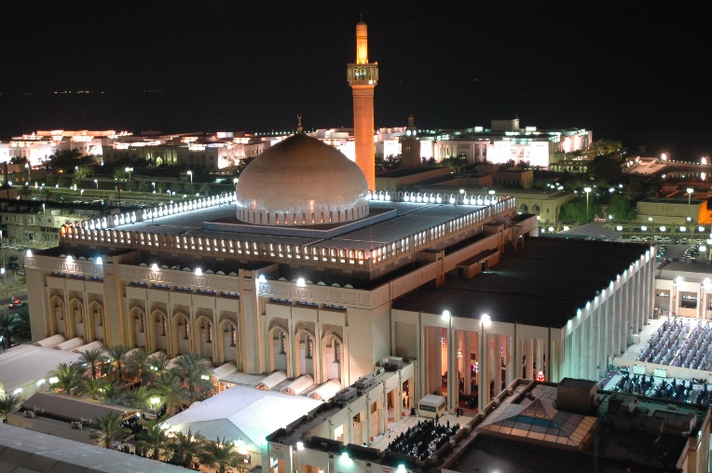
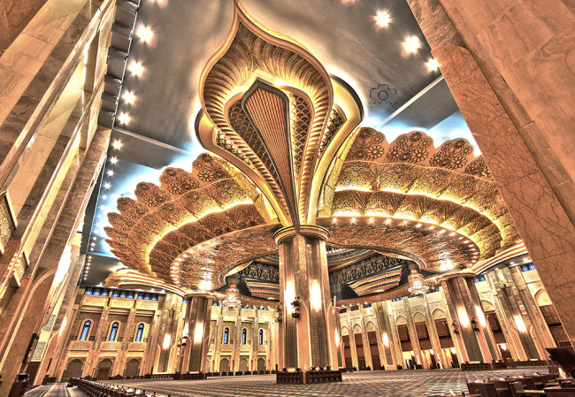
Grand Mosque

Slide 17
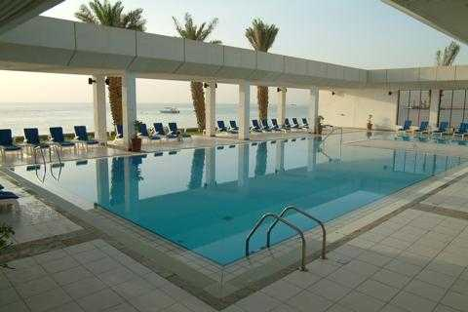
Hilton Beach & Pool

Slide 18
Shuwaikh Beach

Slide 19
Marina Walkway

Slide 20
Entertainment Park

Slide 21
Water Play

Slide 22
Ice Skating and Hockey

Slide 23
AL HamraTower

Slide 24
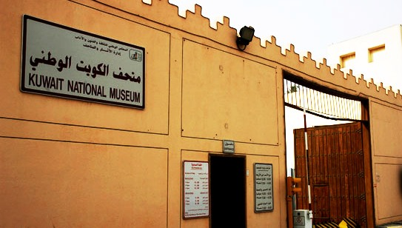
Kuwait National Museum

Slide 25
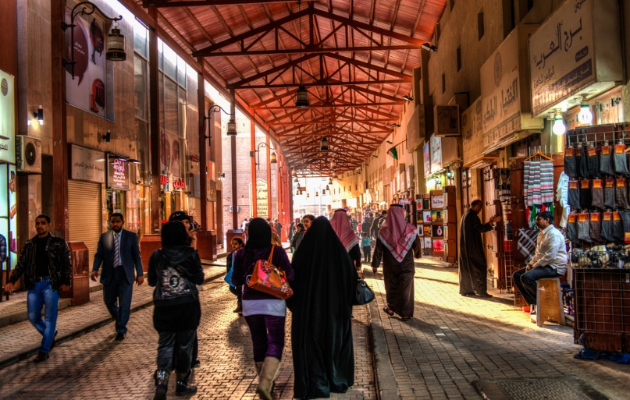
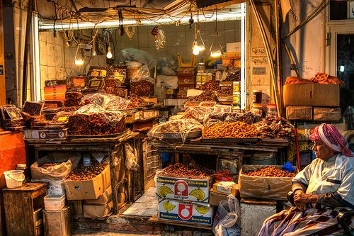
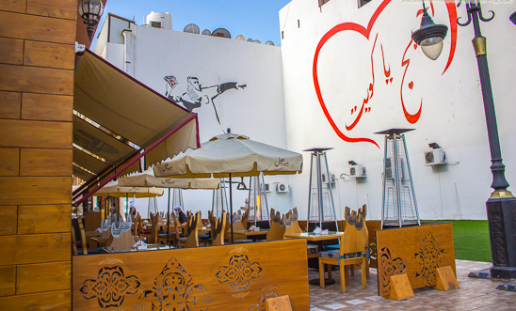
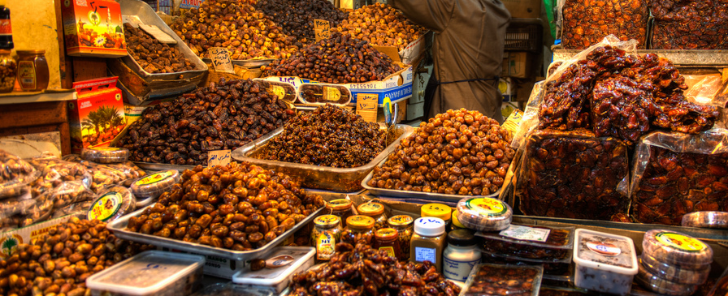
Souk Al-Mubarakiya

Slide 26
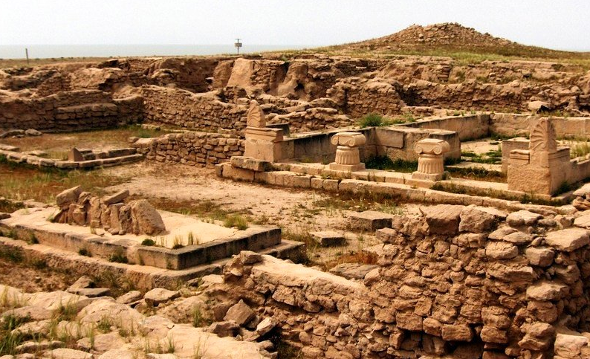
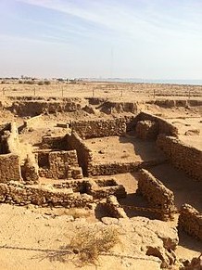
Failaka Island

Slide 27
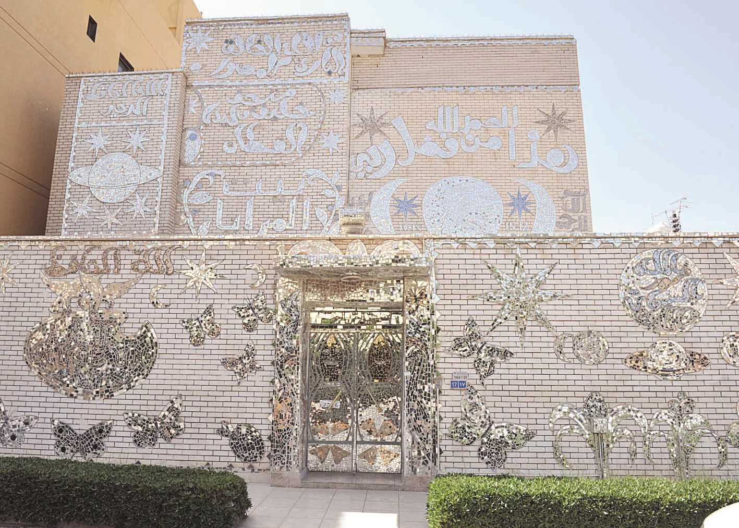
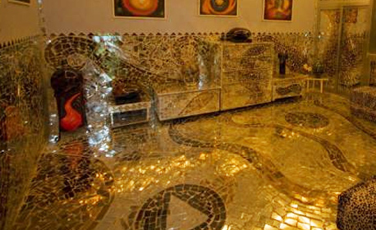
House of Mirrors

Slide 28
Shopping

Slide 29
The Avenues

Slide 30
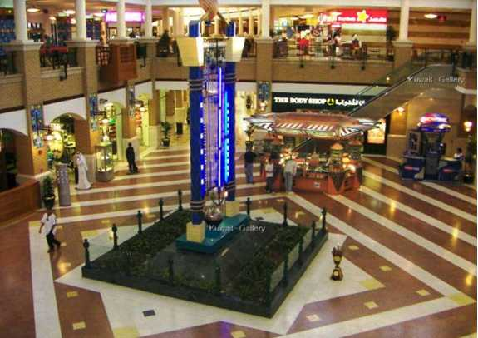
Souq Sharq Mall

Slide 31
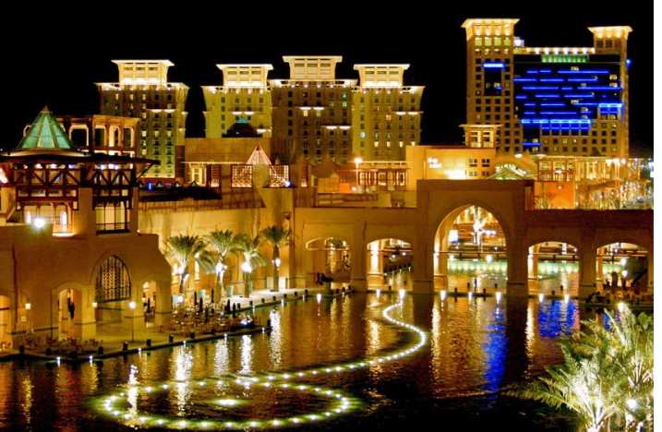
Al Kout Mall

Slide 32
Restaurants

Slide 33
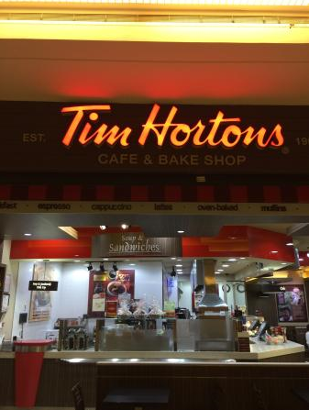
Tim Hortons

Slide 34
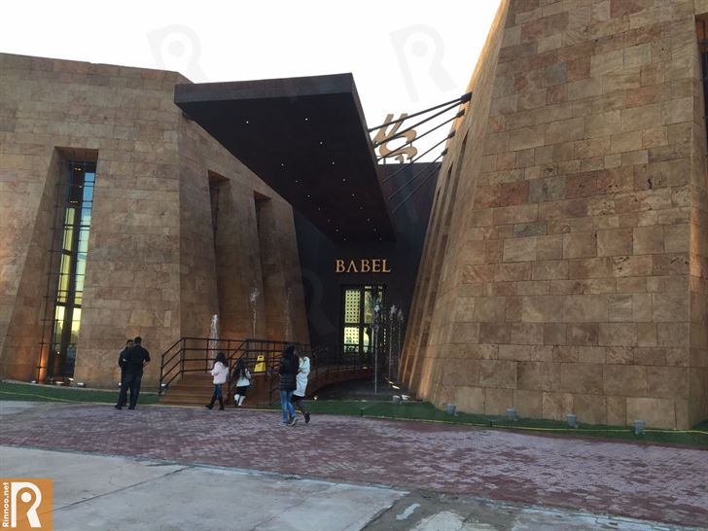
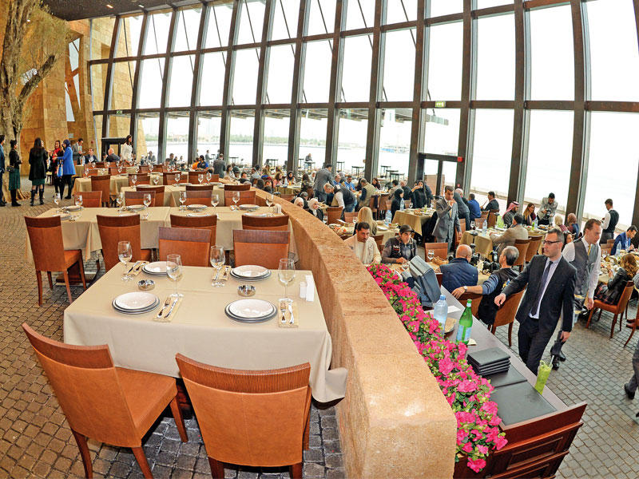
Babel

Slide 35
Cheesecake Factory

Slide 36
Applebee's

Slide 37
Ruby Tuesday

Slide 38
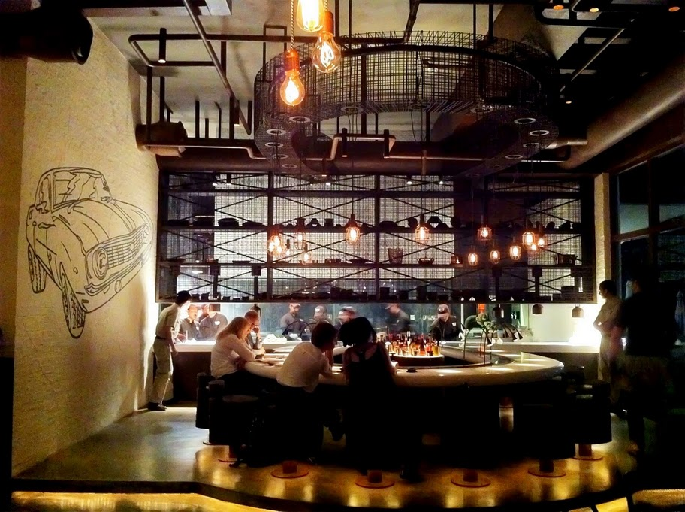
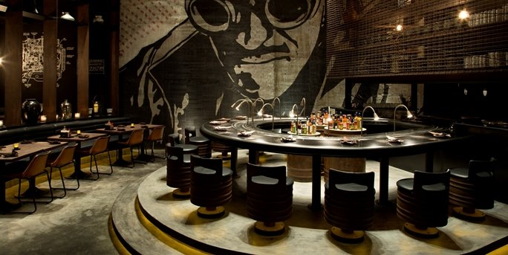

Slide 39
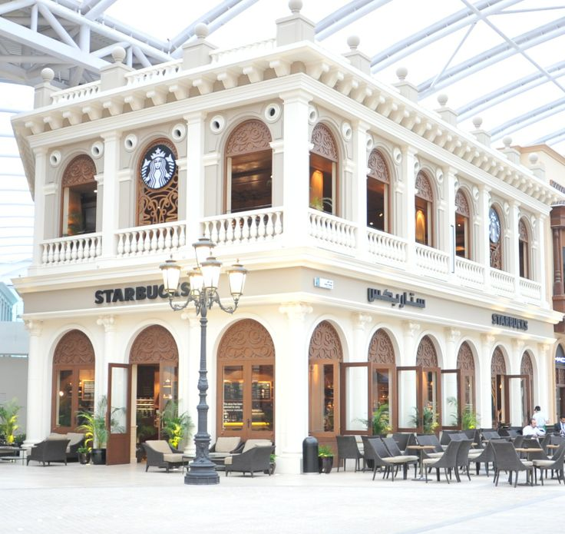
Starbucks

Slide 40
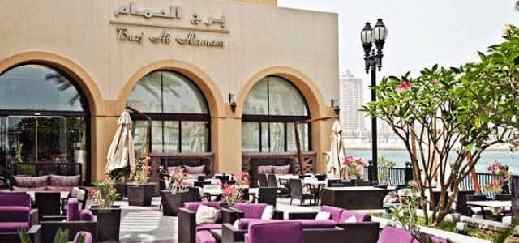
Burj Al-Hamam

Slide 41
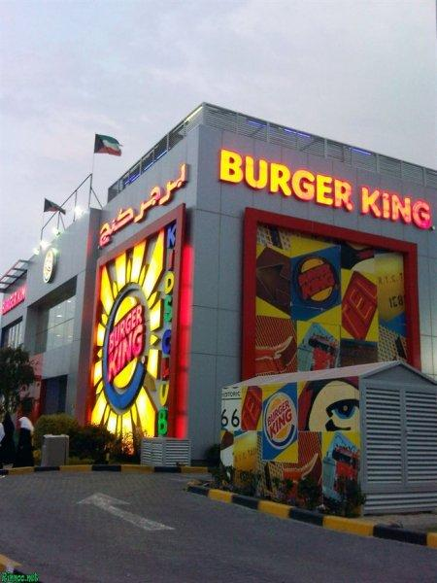
Burger King

Slide 42
Hardee’s

Slide 43
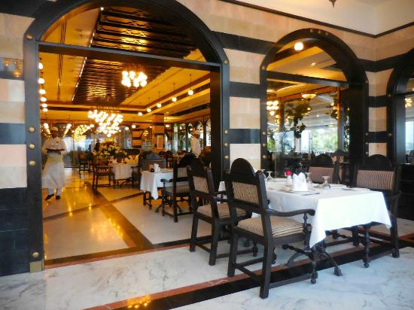
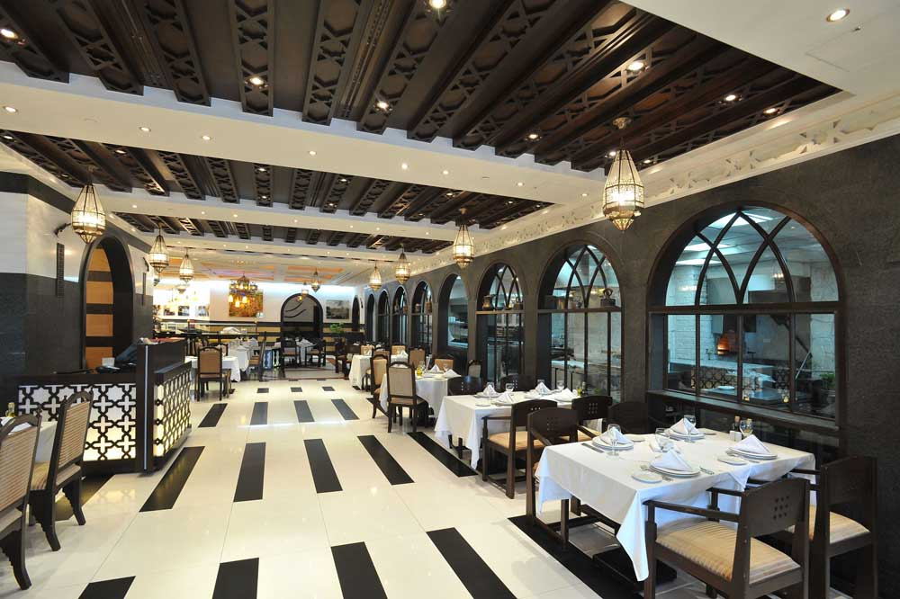
Naranj Restaurant

Slide 44
KFC

Slide 45
Pizza Hut

Slide 46
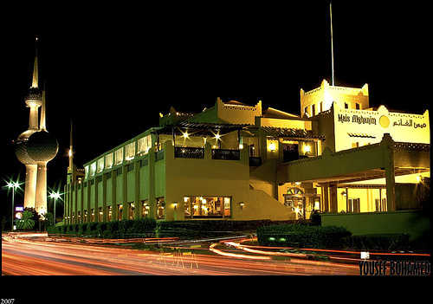
Mais Al Ghanim Restaurant

Slide 47
Kuwaiti Tradition

Slide 48
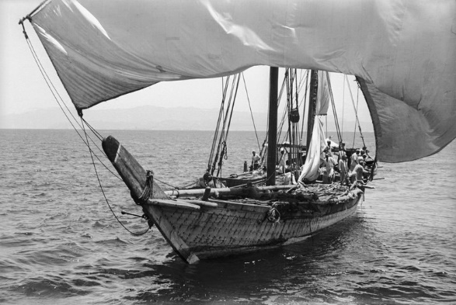
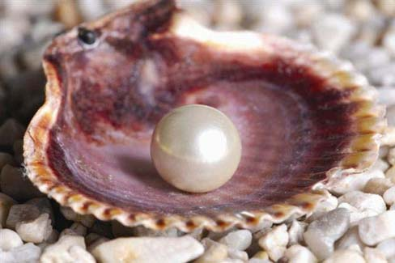
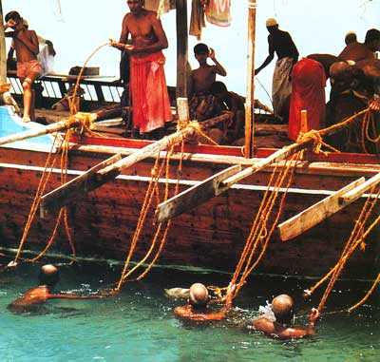
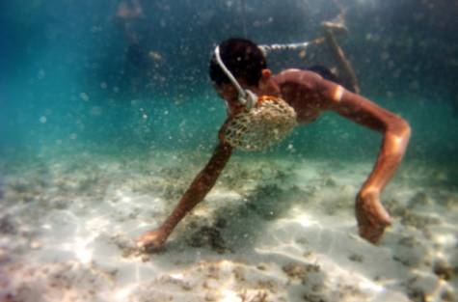
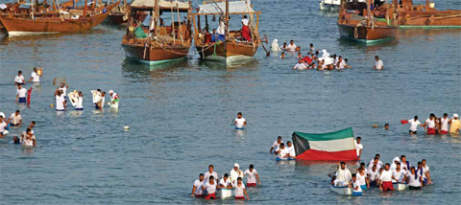
Pearl Diving

Slide 49
Diwaniya

Slide 50
Sadu House

Slide 51
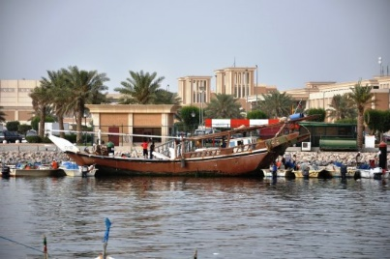
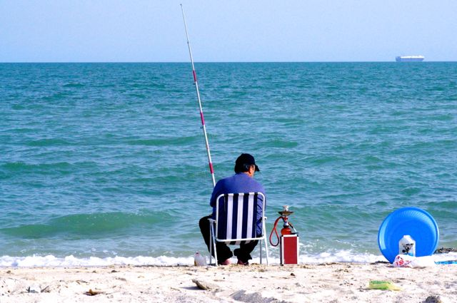
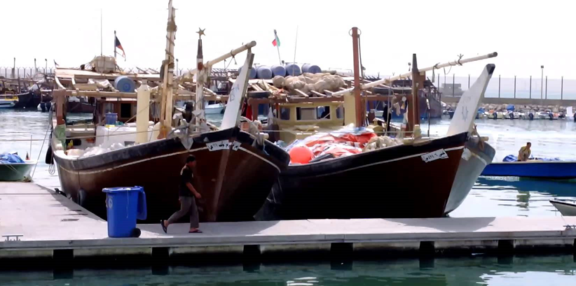
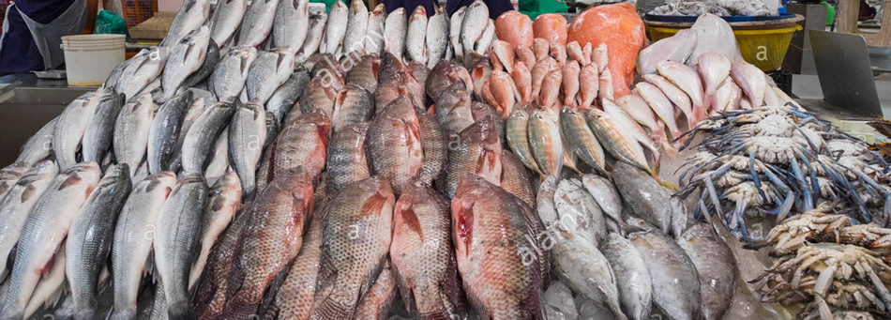
Fishing

Slide 52
Vegetable Market

Slide 53
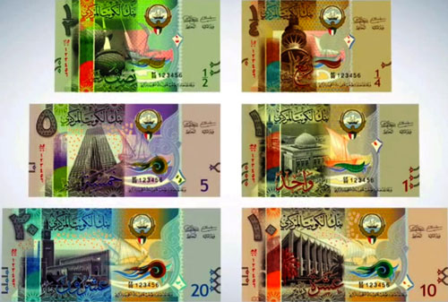
Kuwaiti Dinar

Slide 55
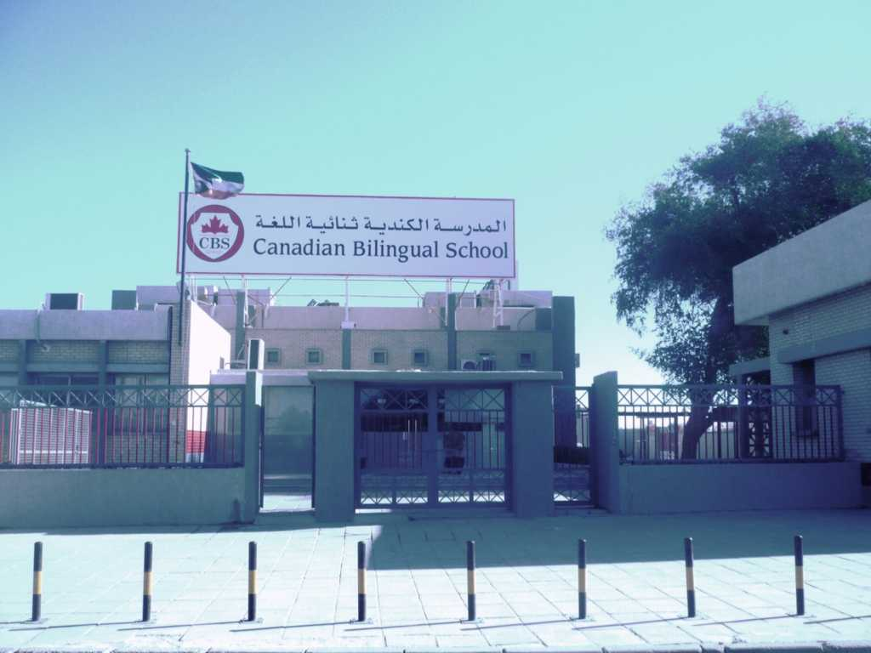
Front Entrance

Slide 56
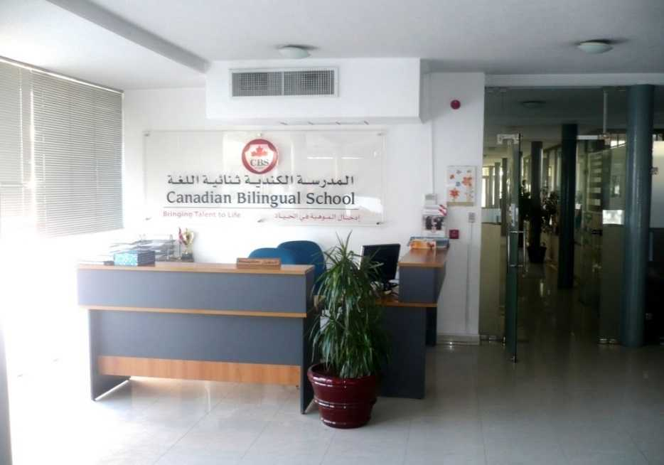
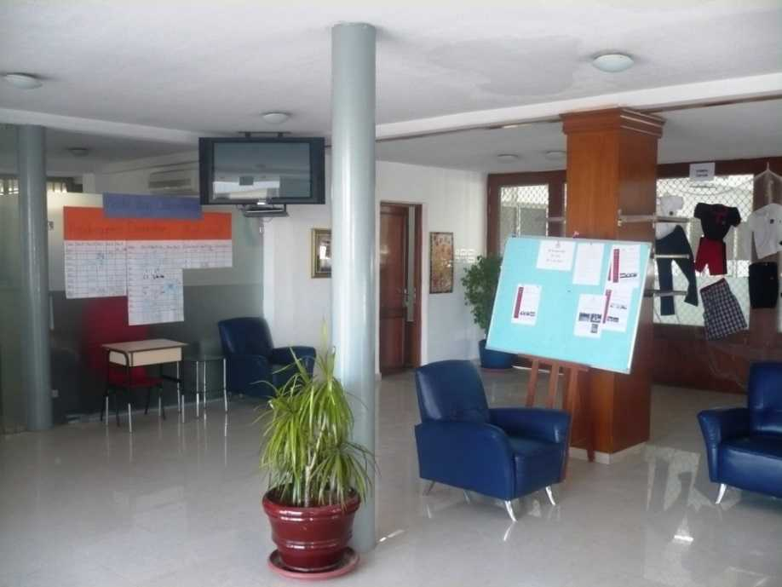
Front Foyer

Slide 57
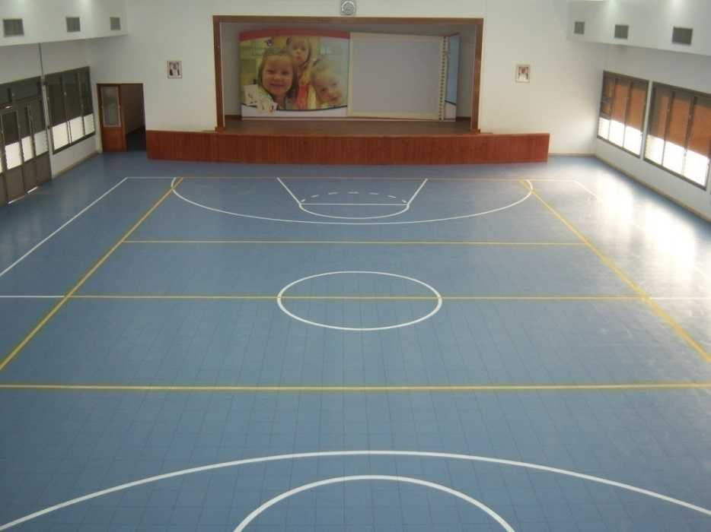
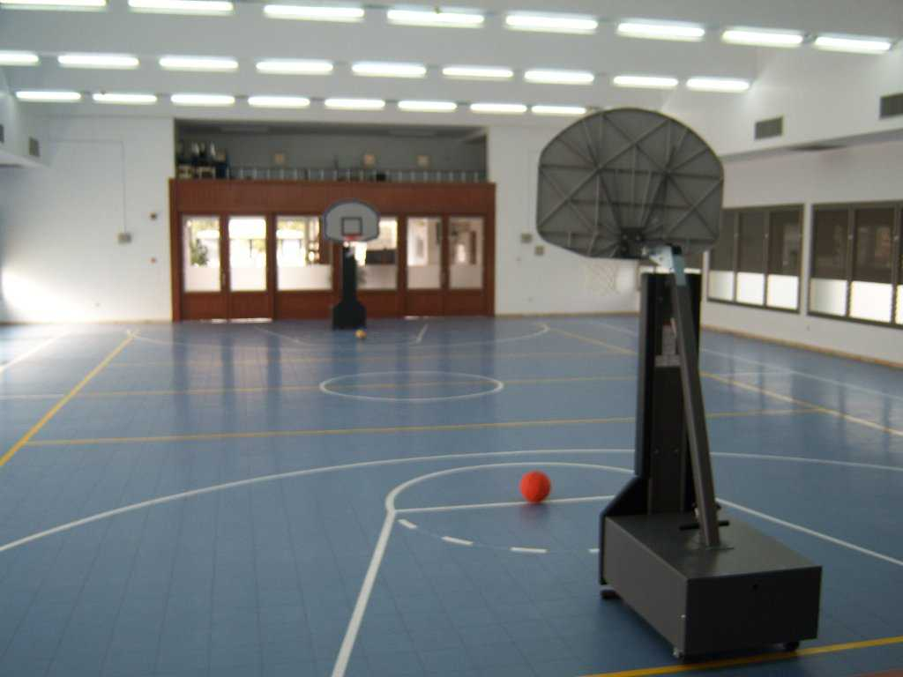
Auditorium / Gym

Slide 58
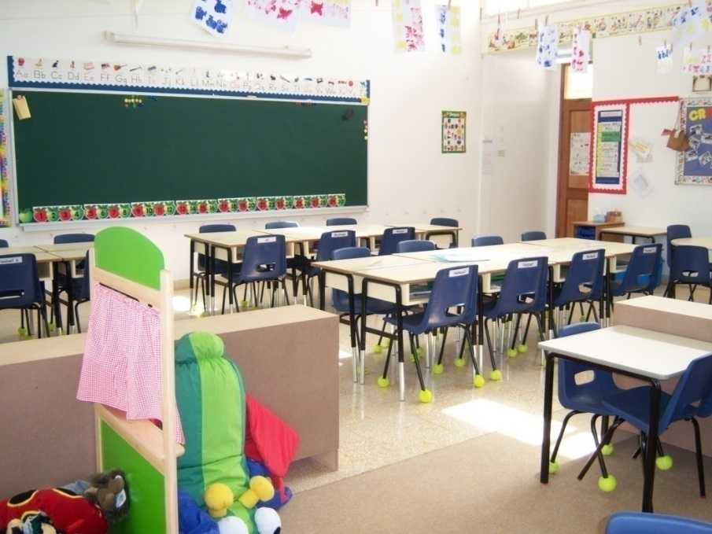
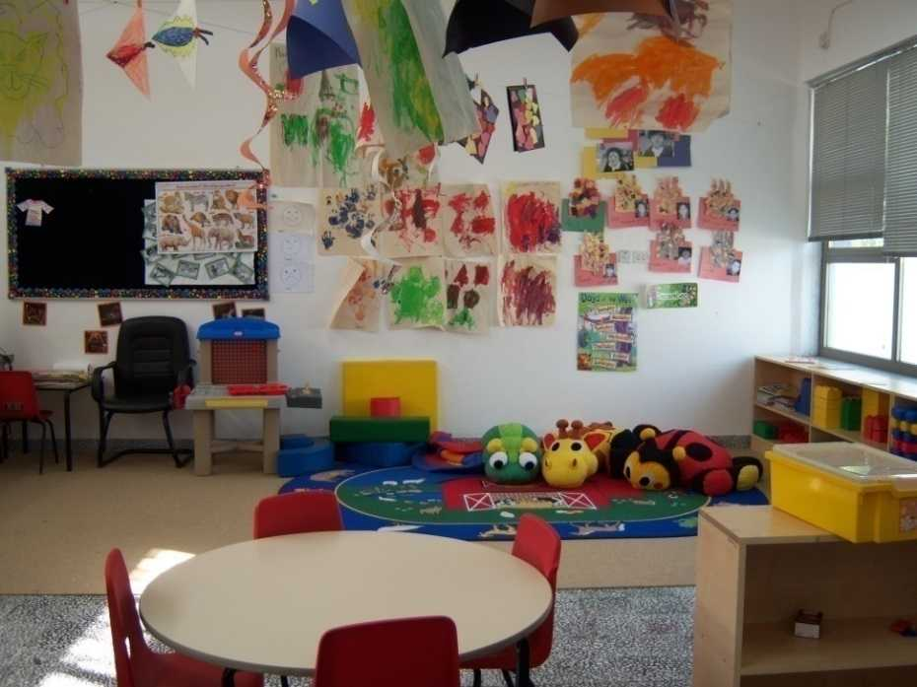
Classrooms

Slide 59
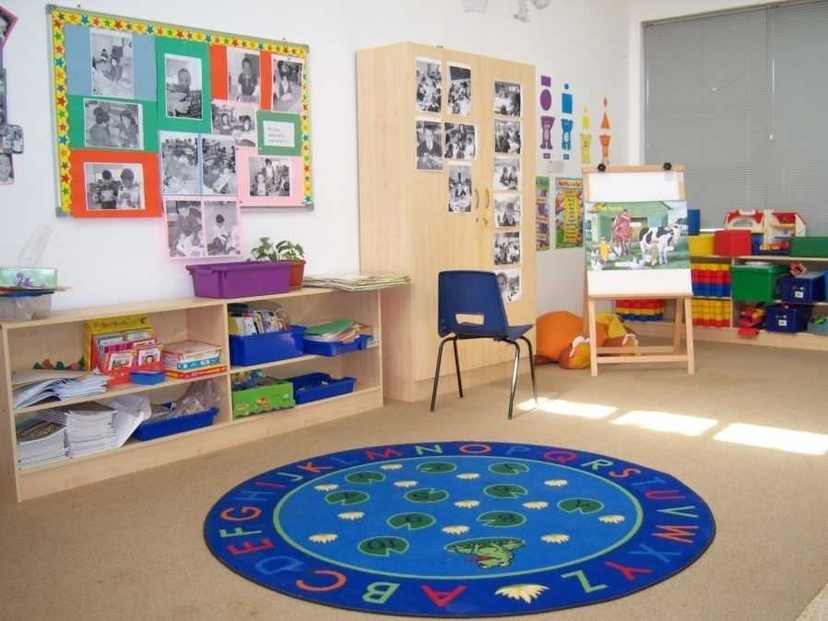
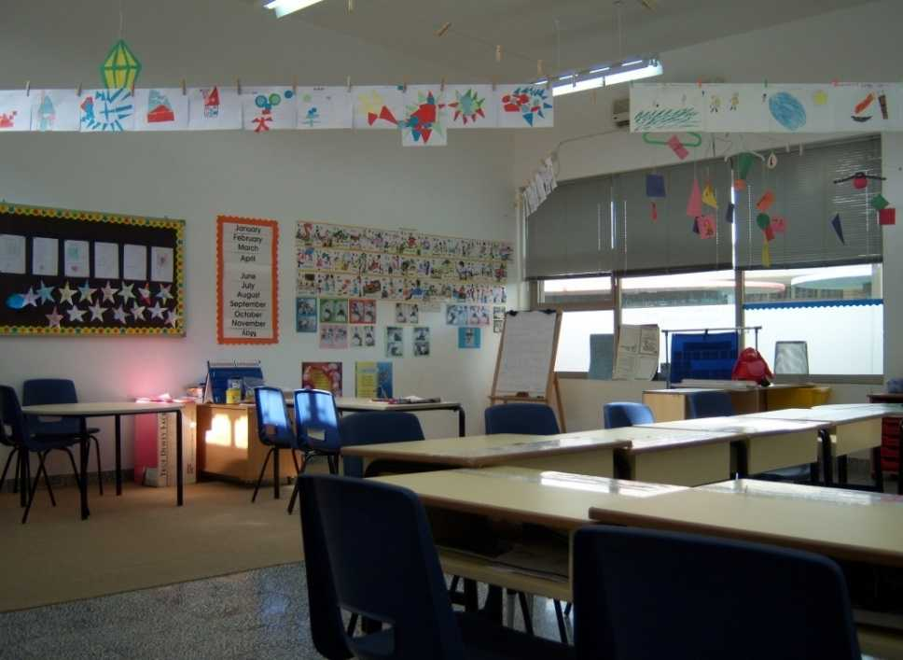
Classroom Setup

Slide 60
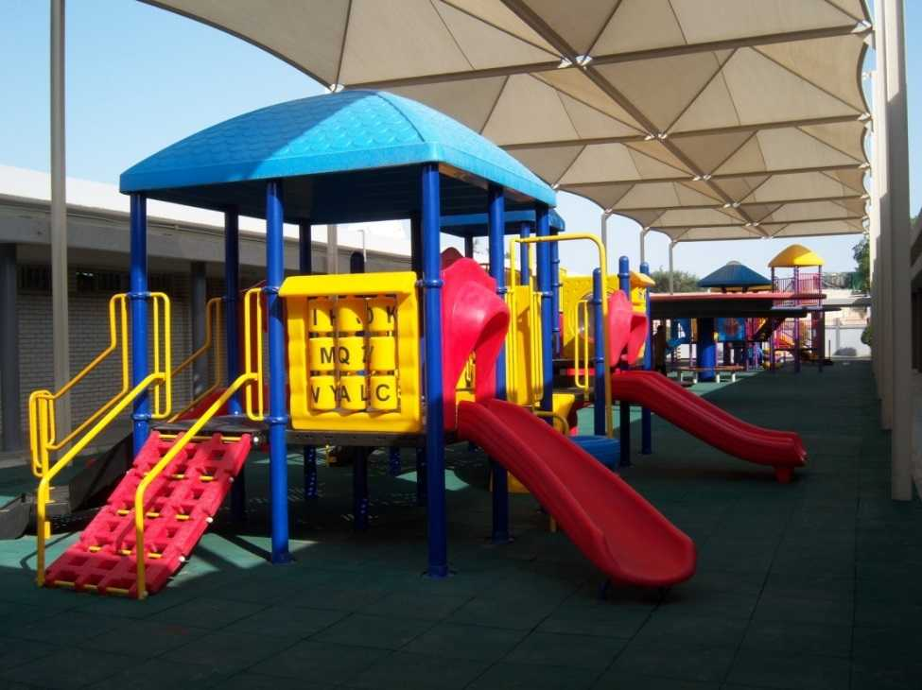
Play Areas

Slide 61
Soccer Field

Slide 62
Library

Slide 63
Computer Lab

Slide 64
Apartment Photos

Slide 65
International School Leadership Conference

Slide 66
Kuwait National Day Celebration

Slide 67
Healthy Living Week

Slide 68
Sports Day

Slide 69
Fun day

Slide 70
Book Fair

Slide 71
SK Graduation

Slide 72
Social events for staff

Slide 73
Bowling

Slide 74
Visit to Chalet

Slide 75
Yacht Trip

Slide 76
Desert Camping

Slide 77
Canadian Bilingual School
Canadian Bilingual School is located in a developing area of South Khaitan in wealthy and safe Kuwait. Our school first opened its doors to students in September 2007. Our school includes JK through Grade 12, as of September 2019.Canadian Bilingual School has been created to not only promote the strengths and support the weaknesses of children individually but also to challenge each student to flourish intellectually by developing their own special talent.
The school offers a dual language curriculum, English and Arabic which enables the students to be competent in both languages. Our English curriculum is based on the Ontario curriculum which is supported by all the appropriate texts and resources. The Arabic and Islamic curriculum is provided by the Kuwait MOE.
We have many exciting and challenging programs throughout the academic year that will enhance each child's learning skills and talents thus allowing individual giftedness to flourish, whether it be in the area of art, music, drama, sports or within one of the academic subjects.

Slide 78
Mission Statement
Mission Statement:
At CBS we promote a respectful, safe and supportive environment encouraging high expectations and academic success.
Core Beliefs:
We believe in:
Individual accountability.
Having a positive belief in people.
Developing critical thinking.

Slide 79
Canadian Bilingual School facilities :
Spacious, bright classrooms each with computer access and a class library.
An auditorium/gym for school and sports activities
Large play areas.
School library.
Computer labs.
Carefully nurtured garden settings for both the interior and the exterior of the school.
Soccer fields.

Slide 80
Curriculum
Curriculum is the driving force behind all teaching. Canadian Bilingual School students require consistent, challenging programs that will capture their interest, stimulate creative thinking and problem solving, develop a co-operative and independent approach to team work as well as prepare them for a lifetime of learning. They require knowledge and skills that will help them compete and excel at the global level and allowing their talent to lead lives of integrity and satisfaction both as citizens and as individuals.
Canadian Bilingual School follows the Ontario curriculum supported by other North American resources thus creating challenges and meeting the creative and academic needs of each individual learner.

Slide 81
Curriculum
Teachers use Curriculum expectations and achievement level charts to ensure the expectations of the appropriate grade level are met. These charts are used in lesson and unit planning for the teacher, and are reflected in the report cards and used as references when discussing progress with the parents.
At Canadian Bilingual School, English is the language of instruction in the four core subjects: Language Arts, Mathematics, Science and Social Studies, as well as with the Specialist topics: Computers, Art, Library and Physical Education.
Arabic and Islamic Studies are significant parts of the curriculum as mandated by the Kuwait Ministry of Education.
As Canadian Bilingual School teaches both English and Arabic skills, the two languages are taught with integration as a goal. The common themes as well as shared days of celebration, are a focus of our program.

Slide 82
Curriculum
Teachers will plan activities that blend materials in an interactive way. Various components are approached through independent reading, shared reading, read-a-loud and use of the media. The writing process will be followed - prewriting, drafting, revision, editing, publishing. Instructional approaches include - modelled writing, guided and independent writing. When developing the Mathematics program, teachers weave together related expectations as well as relevant mathematical processes such as a hands-on-approach using manipulatives. Teachers bring enthusiasm and varied teaching approaches to the classroom, addressing different student needs and ensuring sound learning opportunities for each student.

Slide 83
Curriculum
It is important for teachers to use a variety of instructional assessment and evaluation strategies, in order to provide numerous opportunities for students to develop their ability to solve problems, reason mathematically, and connect the mathematics they are learning to the real world around them. Opportunities to relate knowledge and skills to wider contexts will motivate students to learn and to become lifelong learners.
Canadian Bilingual School uses a wide range of diverse texts and resources to support the curriculum – all North American or British published books and teaching materials. This is important as we are fulfilling a wide range of requirements, skills and talents across our school population. The children's needs will be well met.

Slide 84
Talent
As our Mission Statement says, we are "Bringing Talent to Life" for each of our students. The academic area does not always provide a venue for such success in the case of all students.
We therefore encourage all opportunities to nurture talent and develop the arts:
- dance - choir - drama
- plays - visual arts - music
- sports involvement through activities such as: soccer, basketball, volleyball, track & field
All these events are acknowledged through daily classroom recognition and weekly awards assemblies. We use our daily planner to keep parents updated of upcoming assignments and tests. When a child accomplishes a feat, wins an award, reads a good book, presents at a musical recital or is acknowledged at a sports event, the parents are encouraged to inform the school about it using the communication book.

Slide 85
Accreditation
Canadian Bilingual School has been accredited by Middle States Association of Colleges and Schools Commissions on Elementary and Secondary Schools from KG to Grade 12

Slide 86
Contact Us
E-mail : careers@cbskuwait.com
Address: Block 2, Zaid Al Khalil Street, Ibn Hesham Kindergarten Building, South Khaitan, Kuwait
Phone : (965) – 24744023 Fax : (965) – 24743470
Website : www.cbskuwait.com

